Slide 1
ATAI
Advanced Techniqueof Artificial Intelligence
ATAI
ChongqingUniversity _{AdvancedTechniqueof}
of Technology Artificial Intelligence
Chongqing University of
Technology
Chongqing University ^{ATAI}
_{of Technology} Advanced Techniqueof
Artificial Intelligence
Chongqing University of Technology
Chongqing University of Technology
CLGSI: a multimodal sentiment analysis framework based on contrastive learning guided by sentiment intensity
Code:None
2024.6.2 •ChongQing
—— NAACL 2024
Reported by YaoChen Li
1

Slide 2
ATAI
AdvancedTechniqueof
Artificial Intelligence
ATAI
ChongqingUniversity _{AdvancedTechniqueof}
of Technology Artificial Intelligence
ChongqingUniversity of Technology
Motivation
(1)Most of existing methods based on contrastive learning lacks more detailed learning of the distribution of sample pairs with different sentiment intensity differences.
A: {y1=-0.4, y2=+1} and B: {y1=-0.4,y3=+0.6}
(2)Limited research has been conducted on the fusion of each modality representation obtained.

Slide 3
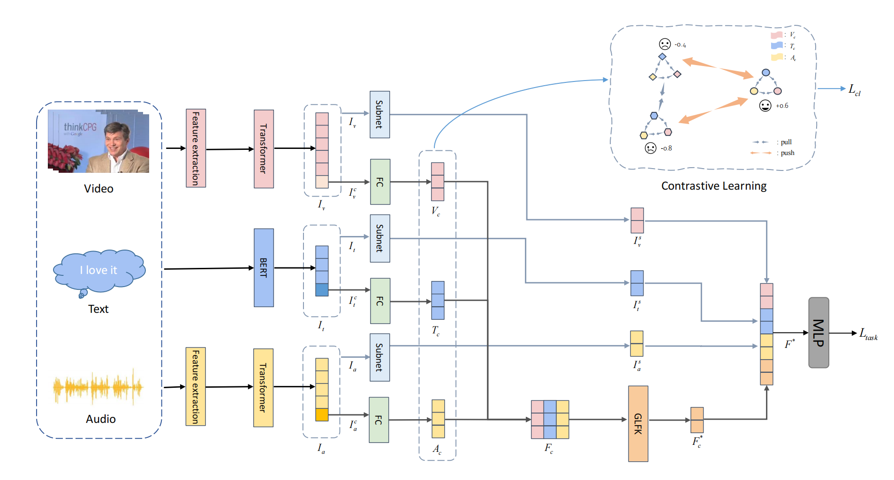
ChongqingUniversity of Technology
ATAI
AdvancedTechniqueof
Artificial Intelligence
ATAI
ChongqingUniversity _{AdvancedTechniqueof}
of Technology Artificial Intelligence
Overview

Slide 4
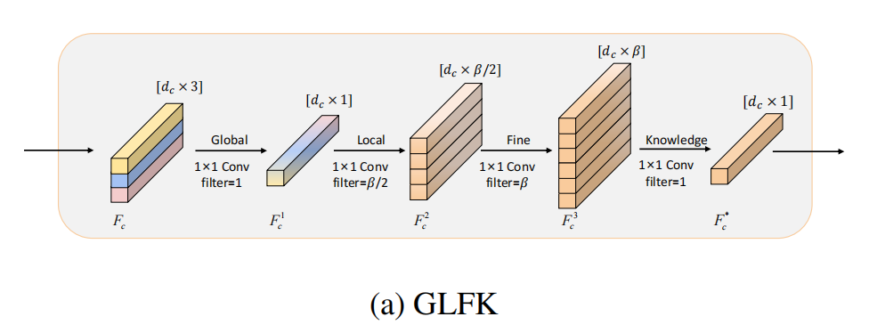
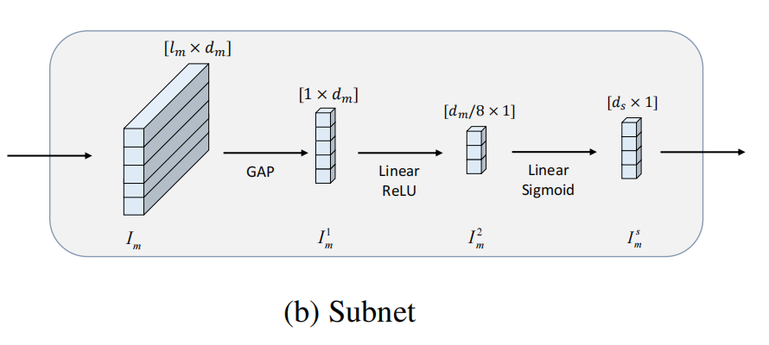
ChongqingUniversity of Technology
ATAI
AdvancedTechniqueof
Artificial Intelligence
ATAI
ChongqingUniversity _{AdvancedTechniqueof}
of Technology Artificial Intelligence
Overview

Slide 5
ChongqingUniversity of Technology
ATAI
AdvancedTechniqueof
Artificial Intelligence
ATAI
ChongqingUniversity _{AdvancedTechniqueof}
of Technology Artificial Intelligence
Method
(1)

Slide 6
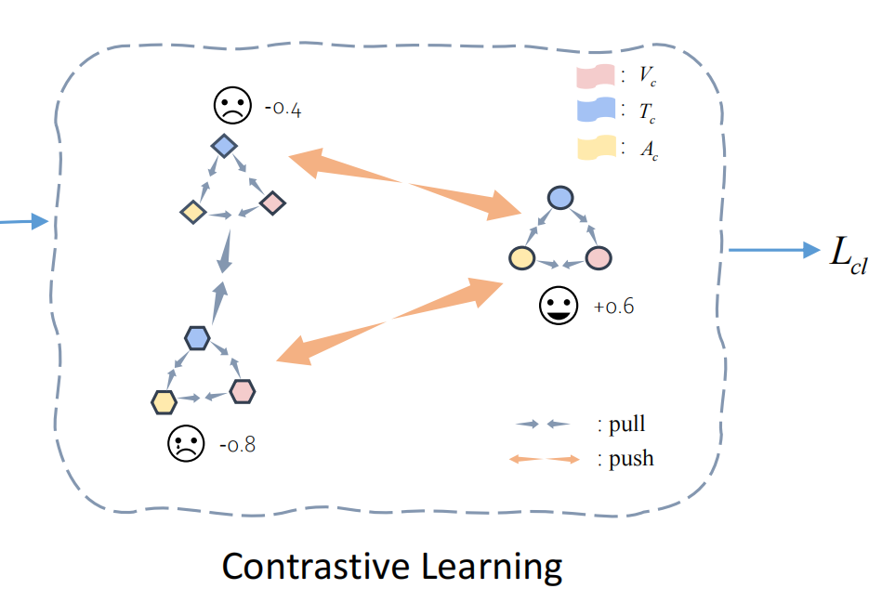
ChongqingUniversity of Technology
ATAI
AdvancedTechniqueof
Artificial Intelligence
ATAI
ChongqingUniversity _{AdvancedTechniqueof}
of Technology Artificial Intelligence
Method
(2)
(3)
(4)
(5)

Slide 7
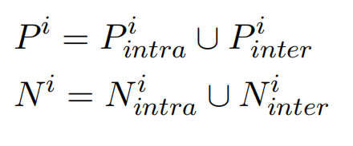
ChongqingUniversity of Technology
ATAI
AdvancedTechniqueof
Artificial Intelligence
ATAI
ChongqingUniversity _{AdvancedTechniqueof}
of Technology Artificial Intelligence
Method
(6)
(7)
(8)

Slide 8
ChongqingUniversity of Technology
ATAI
AdvancedTechniqueof
Artificial Intelligence
ATAI
ChongqingUniversity _{AdvancedTechniqueof}
of Technology Artificial Intelligence
Method
(9)
(10)
(11)
(12)

Slide 9
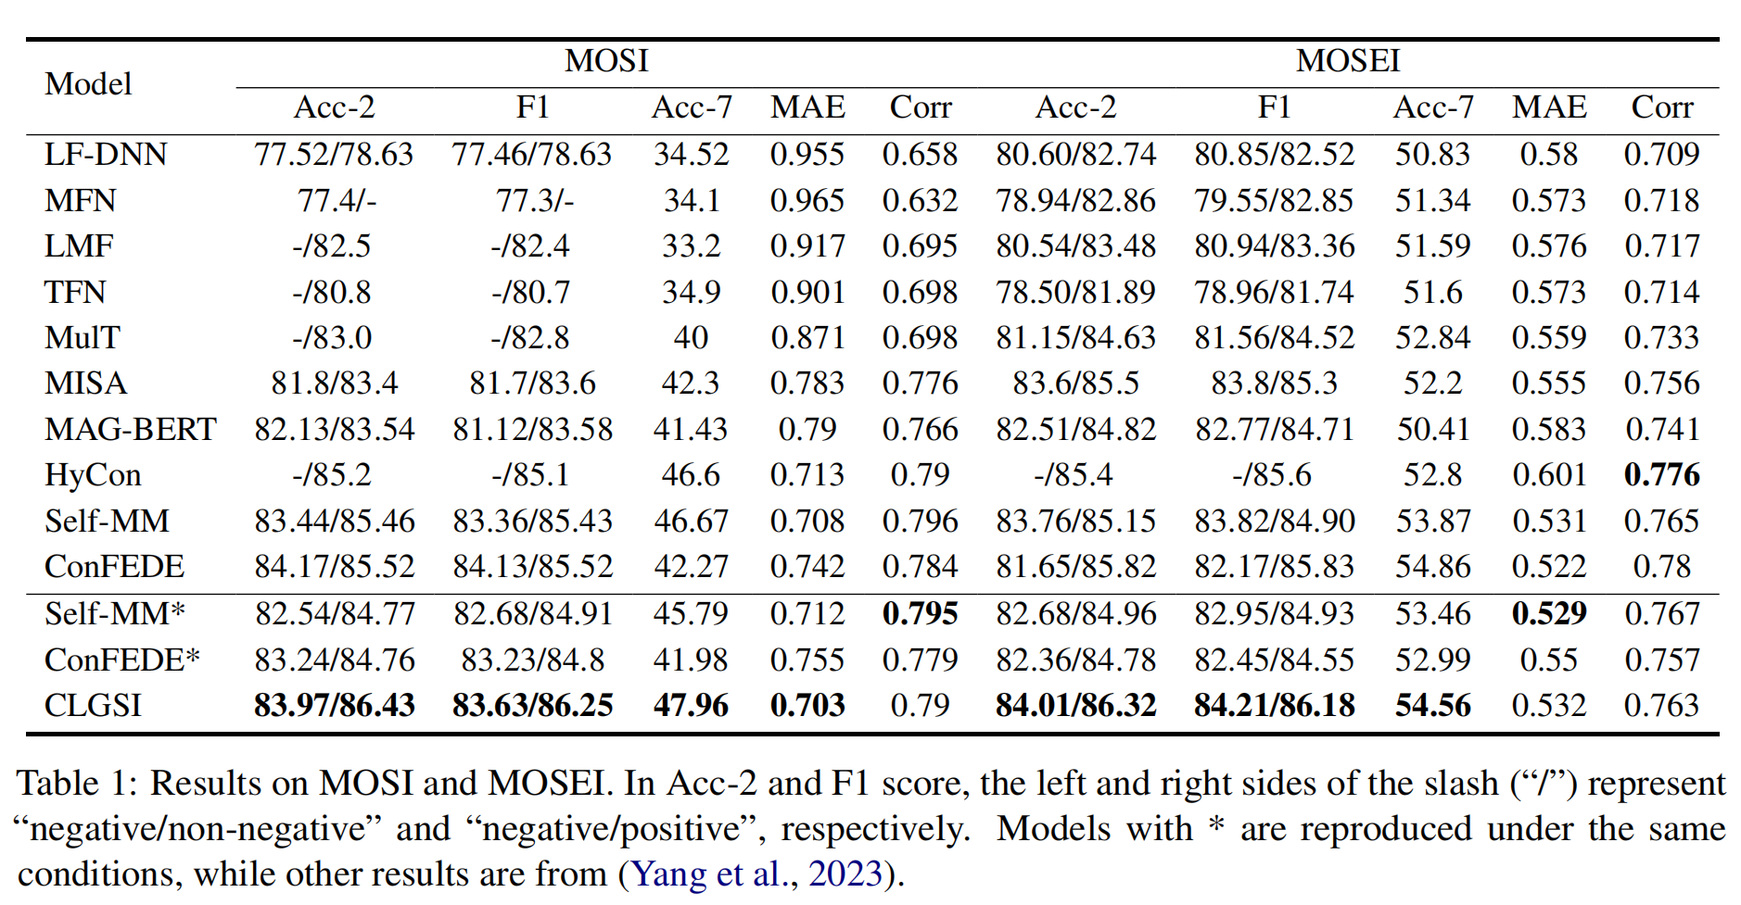
ATAI
AdvancedTechniqueof
Artificial Intelligence
ATAI
ChongqingUniversity _{AdvancedTechniqueof}
of Technology Artificial Intelligence
ChongqingUniversity of Technology
Experiments

Slide 10
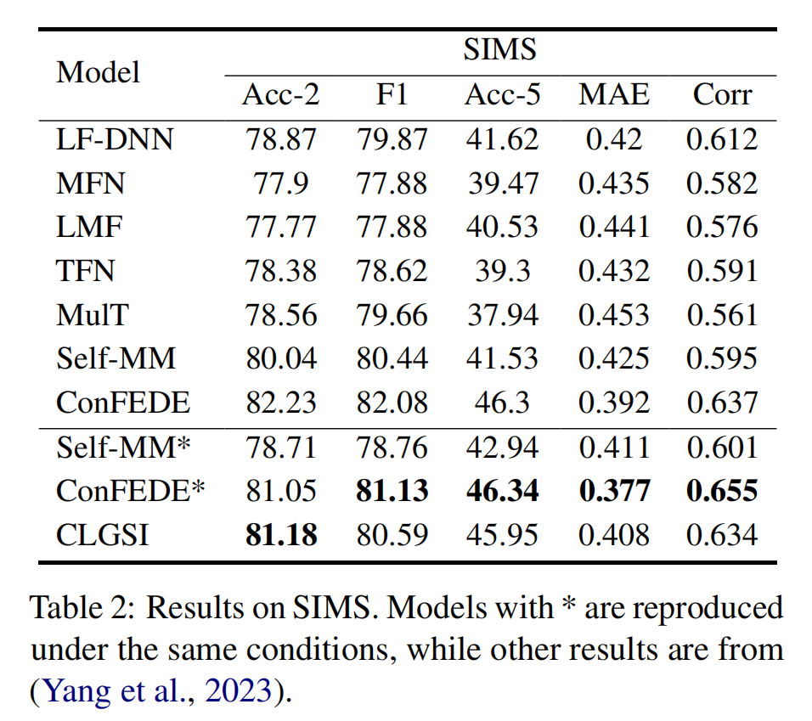
ATAI
AdvancedTechniqueof
Artificial Intelligence
ATAI
ChongqingUniversity _{AdvancedTechniqueof}
of Technology Artificial Intelligence
ChongqingUniversity of Technology
Experiments

Slide 11
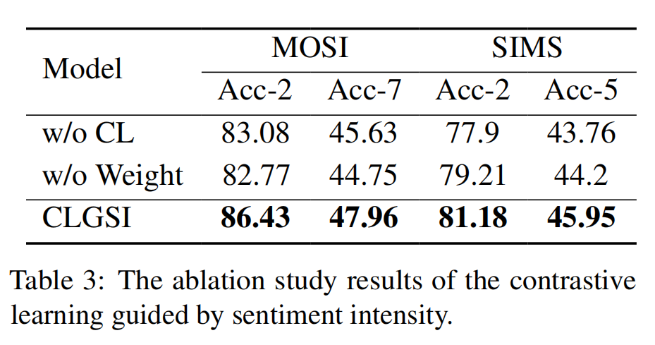
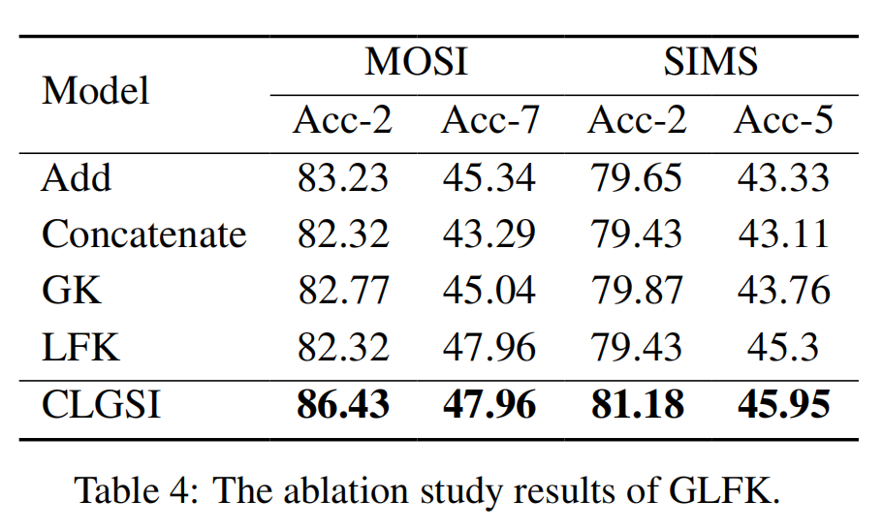
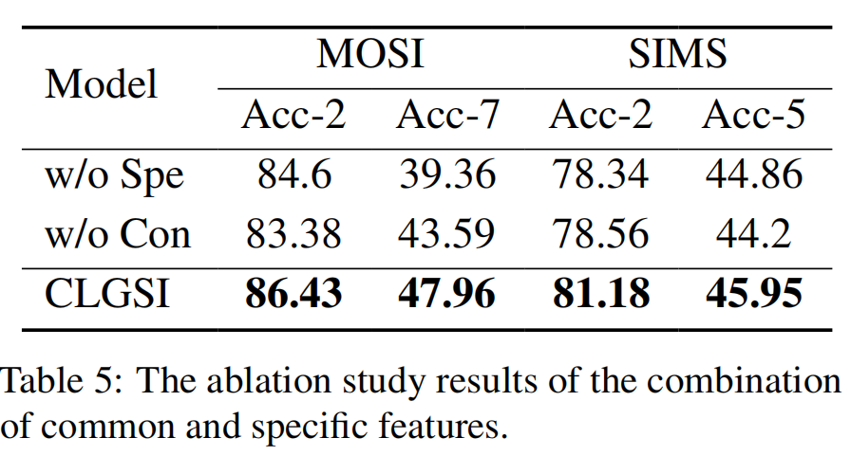
ChongqingUniversity of Technology
ATAI
AdvancedTechniqueof
Artificial Intelligence
ATAI
ChongqingUniversity _{AdvancedTechniqueof}
of Technology Artificial Intelligence
Experiments

Slide 12
ChongqingUniversity of Technology
ATAI
AdvancedTechniqueof
Artificial Intelligence
ATAI
ChongqingUniversity _{AdvancedTechniqueof}
of Technology Artificial Intelligence
Thanks!

